Slide 1
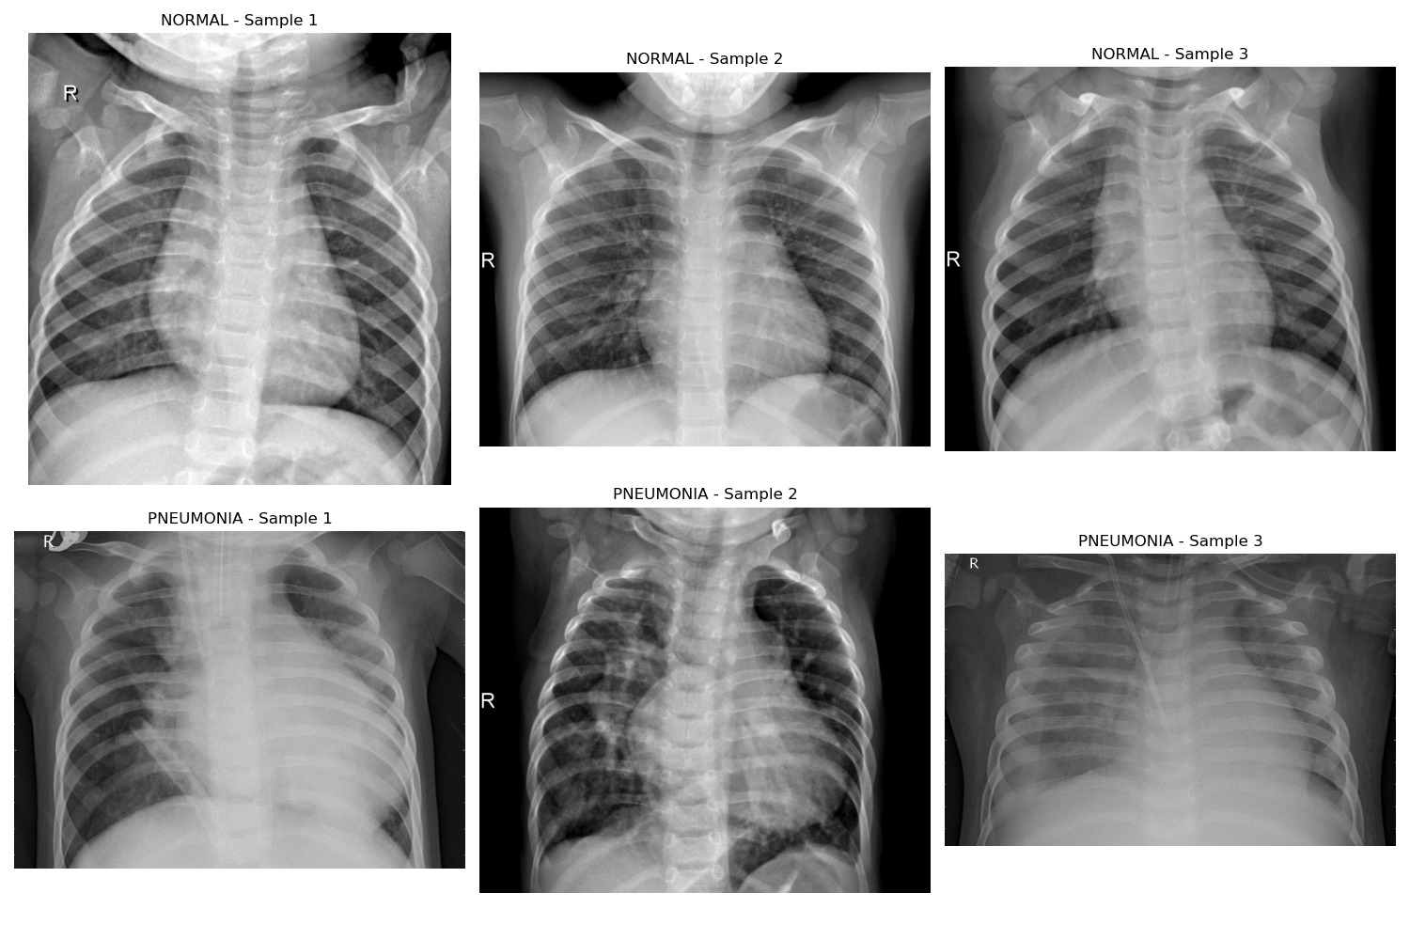
How AI is Advancing Early Pneumonia Detection and Improving Patient Care: Driving Better Patient Outcomes through AI-Based Chest X-Ray Analysis
Denali Carpenter

Slide 2



Why Pneumonia Matters
Widespread & Serious
Importance of Early Detection
Resource Constraints
Pneumonia is a leading cause of hospitalization and death worldwide, especially among young children and older adults.
Many healthcare facilities face a shortage of radiologists, making timely diagnosis challenging.
Prompt diagnosis can significantly reduce complications, hospital stays, and overall mortality rates.

Slide 3



How AI Can Help
Faster X-Ray Analysis
High Accuracy
Better Patient Outcomes
AI can quickly flag potential pneumonia cases on chest X-rays, acting as an extra set of expert eyes for busy radiologists.
Advanced deep learning models have demonstrated results comparable to experienced clinicians and radiologists, ensuring fewer missing cases.
Earlier detection means faster treatment and improved recovery, ultimately saving lives and resources.
By harnessing AI for chest X-ray interpretation, healthcare providers can deliver more efficient, accurate, and timely pneumonia diagnoses – improving both patient outcomes and the overall healthcare system.

Slide 4


Overview
1. Problem Statement
4. Data Processing
Use machine learning to classify chest x-rays and evaluate efficacy.
Images were prepped for use in traditional ML and Deep Learning
2. Data
5. Modeling
Chest X-Ray images from academic research were used.
Use traditional ML, neural networks, and transfer learning
3. Data Exploration
6. Conclusion
Image differences between pneumonia and healthy were explored.
Best model comparable to trained radiologist.
This presentation showcases how advanced machine learning techniques can revolutionize pneumonia detection, leading to better patient outcomes and more efficient treatment strategies.

Slide 5
1. Problem Statement
Evaluating the Effectiveness of Machine Learning Techniques for Bacterial and Viral Pneumonia Detection in Chest X-Ray Images

Slide 6

Research Questions
What is the most effective and efficient model for predicting pneumonia diagnoses from chest x-ray images?
Follow Up: Can we accurately distinguish between viral and bacterial pneumonia via chest x-ray images?
©2025 Inteleos Inc. Proprietary and Confidential. All Rights Reserved.

Slide 7
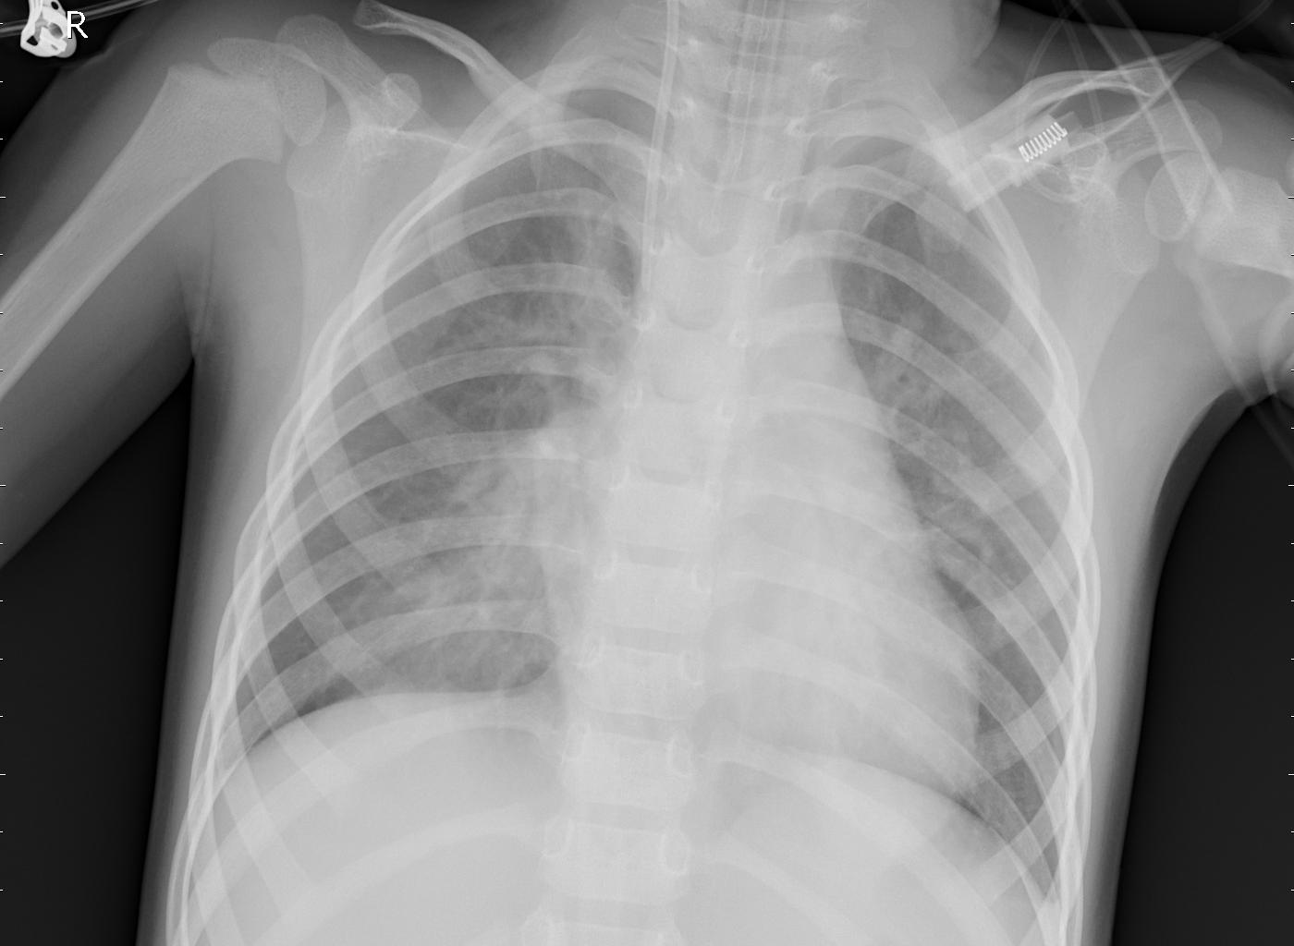
2. Data
Chest X-ray Images

Slide 8
Raw Chest X-Ray Images

Slide 9


Data Overview*
Dataset
Training
Testing
Validation
Total Images
5,216
624
16
NORMAL
1,341
234
8
PNEUMONIA
3,875
390
8
*Counts show dataset before cleaning.
©2025 Inteleos Inc. Proprietary and Confidential. All Rights Reserved.

Slide 10
3. Data Exploration
Examining Differences in PNEUMONIA and NORMAL Images

Slide 11




Data Exploration
Brightness & Contrast Differences
Texture Patterns in Images
Sharpness and Blurriness
Simplifying the Data for AI
Analyzed X-ray brightness and contrast levels to see how pneumonia images differ from healthy ones.
Examined patterns in the images to detect subtle texture differences that might indicate pneumonia
Checked how sharp or blurry different X-rays were, helping identify key differences between normal and pneumonia cases.
Reduced the complexity of image data while keeping important details, making it easier for AI to learn patterns effectively.
The data analysis revealed key differences between normal and pneumonia X-rays, helping to build an AI model that can detect pneumonia more accurately and efficiently.

Slide 12

Most Images are of Bacterial Pneumonia
©2025 Inteleos Inc. Proprietary and Confidential. All Rights Reserved.

Slide 13
4. Data Processing
Extracting and Adjusting Images to Improve Accuracy

Slide 14




Data Cleaning
Remove Duplicates
Check for corrupt images
Match formatting (size and color)
Augment images
©2025 Inteleos Inc. Proprietary and Confidential. All Rights Reserved.

Slide 15
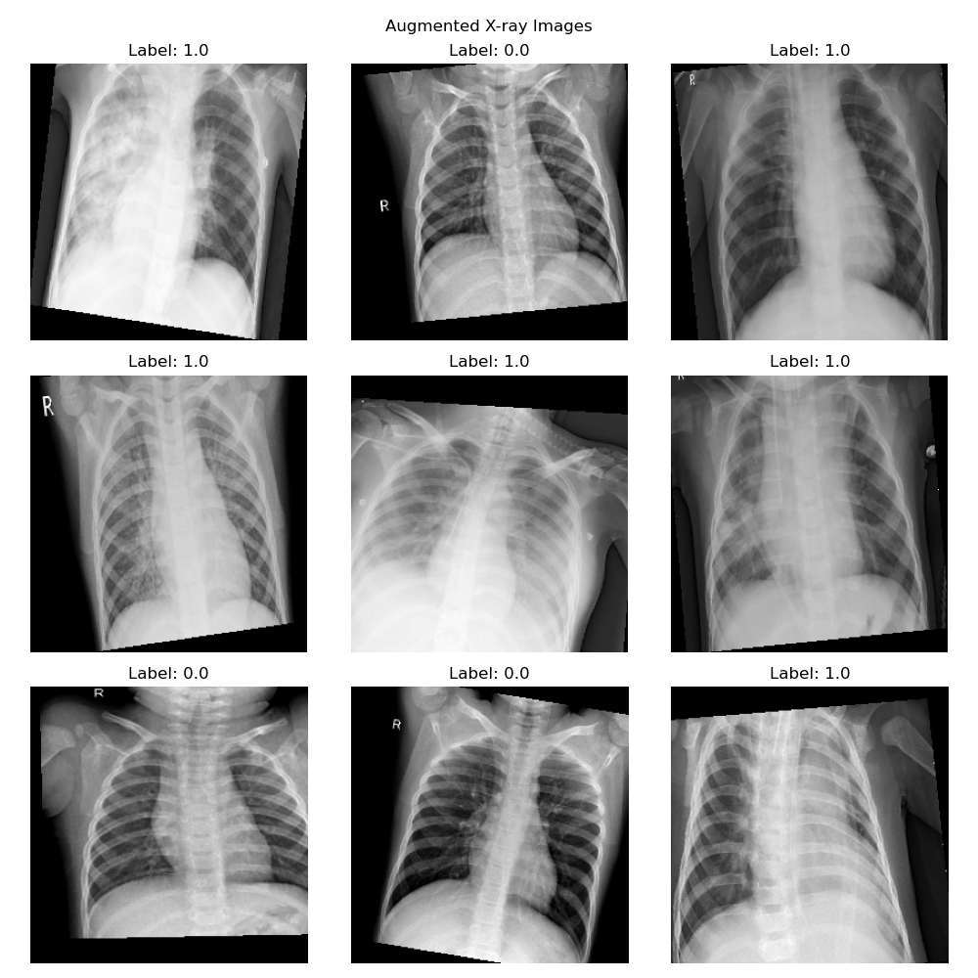

Slide 16
5. Modeling
Building and Testing Traditional Machine Learning and Deep Learning Techniques

Slide 17
Traditional Machine Learning Techniques Used
1
Random Forest Models
(lots of decision trees!)
2
Support Vector Machines
(what if we examined only the most important data points?)
3
Hyperparameter tuning
(adjusting AI model settings for better performance)
©2025 Inteleos Inc. Proprietary and Confidential. All Rights Reserved.

Slide 18
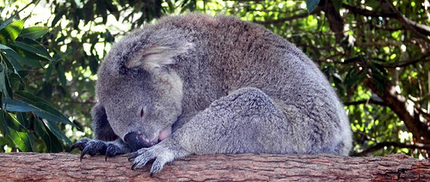
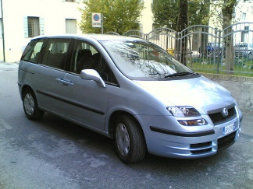

Deep Learning Techniques Used
1
Convolutional Neural Network
(an advanced neural network built for image data)
2
Transfer Learning: VGG16 and DenseNet121
(pretrained AI models designed to recognize patterns in 1000 image categories)
koala
minivan
violin
©2025 Inteleos Inc. Proprietary and Confidential. All Rights Reserved.

Slide 19
The Idea Behind Transfer Learning
VGG16 or DenseNet121
koala
minivan
violin
… 997 other categories

Slide 20
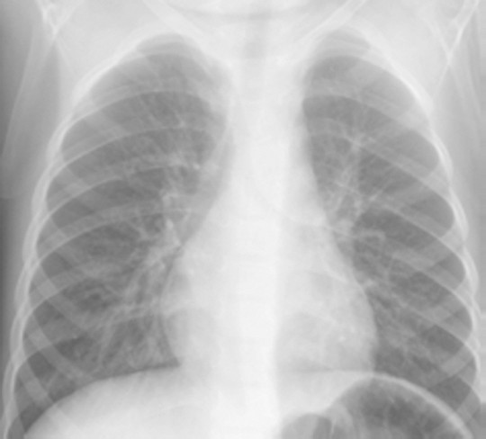
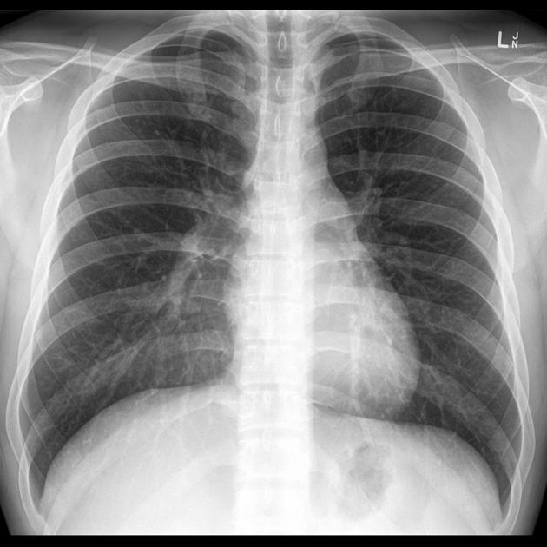
The Idea Behind Transfer Learning
VGG16 or DenseNet121
Retrain the model to recognize pneumonia instead of objects like animals or cars
This isn't the full story—but it's enough to understand how AI can quickly get really good at medical image tasks
pneumonia
healthy/normal

Slide 21
Model Evaluation and Comparison: Accuracy
Accuracy = Percentage of Correctly Identified Images
88%
88%
95%
69%
69%
70%
70%
Tuned Random Forest
Ensemble of Random Forests
Tuned SVM
Base SVM
DenseNet121
Custom CNN
VGG16
©2025 Inteleos Inc. Proprietary and Confidential. All Rights Reserved.

Slide 22






Best model: VGG16 with transfer learning applied
94.82%
93.61%
98.45%
88.74%
Accuracy
(Measures the overall percentage of correct predictions, including both pneumonia and healthy cases.)
Precision
(Measures how often predicted pneumonia cases are correct.)
Recall
(Measures how often the system correctly detects pneumonia when it is present.)
Specificity
(Measures how often the system correctly identifies healthy patients.)
©2025 Inteleos Inc. Proprietary and Confidential. All Rights Reserved.

Slide 23

11%
False Positive Rate
©2025 Inteleos Inc. Proprietary and Confidential. All Rights Reserved.

Slide 24
1.6%
False Negative Rate
©2025 Inteleos Inc. Proprietary and Confidential. All Rights Reserved.

Slide 25
6. Conclusion
What Does this Mean and How Does it Help?

Slide 26
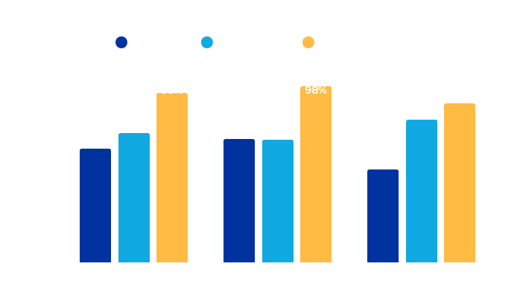
Radiologist and Clinician Performance versus VGG16 Model
Recall (sensitivity) Measures how often the system/individual correctly detects pneumonia when it is present.
Specificity Measures how often the system correctly identifies healthy patients.
©2025 Inteleos Inc. Proprietary and Confidential. All Rights Reserved.

Slide 27
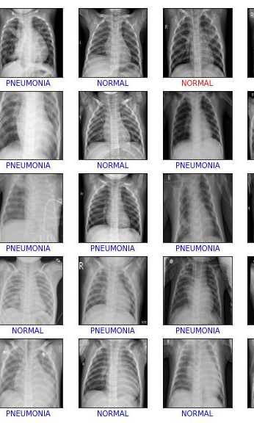
Real-World Impact
The high recall achieved by the deep learning models is critical in a clinical setting, where missing a pneumonia diagnosis could lead to delayed treatment and serious consequences for patients. There is potential for this work to transform healthcare by enabling early and accurate pneumonia detection, which can significantly improve patient outcomes and treatment strategies.

Slide 28



Conclusion
Demonstrated power of deep learning
Potential to transform healthcare
Contribution to 'Uncharted & Unstoppable'
Developed highly accurate and reliable diagnostic tool for pneumonia detection using advanced machine learning techniques, particularly deep learning models.
Has the potential to significantly improve early detection and treatment of pneumonia in healthcare settings, enabling better patient outcomes and more efficient treatment strategies.
This study showcases how innovative technology can drive meaningful change and push boundaries in healthcare.
This study demonstrates the remarkable potential of deep learning in developing accurate and reliable diagnostic tools for pneumonia detection in chest X-ray images. The researchers' work has the power to revolutionize healthcare by enabling early and precise diagnosis, leading to improved patient outcomes and more efficient treatment strategies.

Slide 29



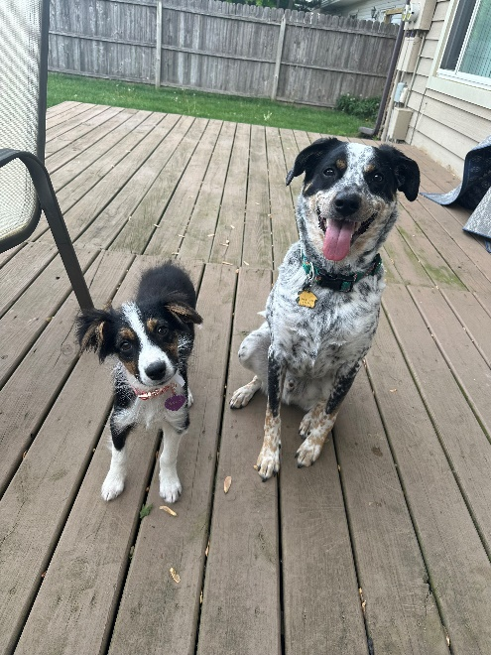
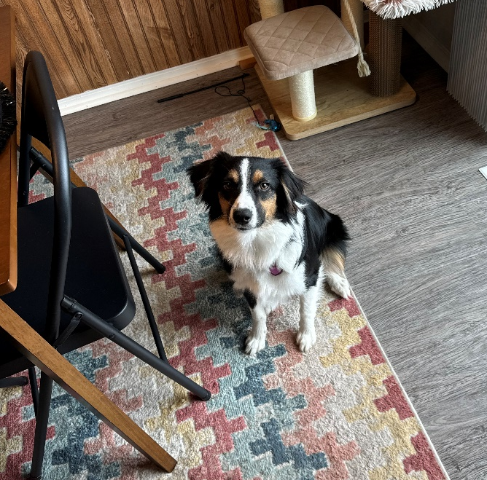

Thank you!

